Slide 1
ASL Image Recognition
Ray Chen

Slide 2
Problem Statement
Build a model to classify the signs for the ASL alphabet

Slide 3
Data
Images and their labels come from kaggle
29 labels, the 26 letters in the alphabet, “nothing”, “space”, and “delete
3000 training images for each label
28 testing images

Slide 4
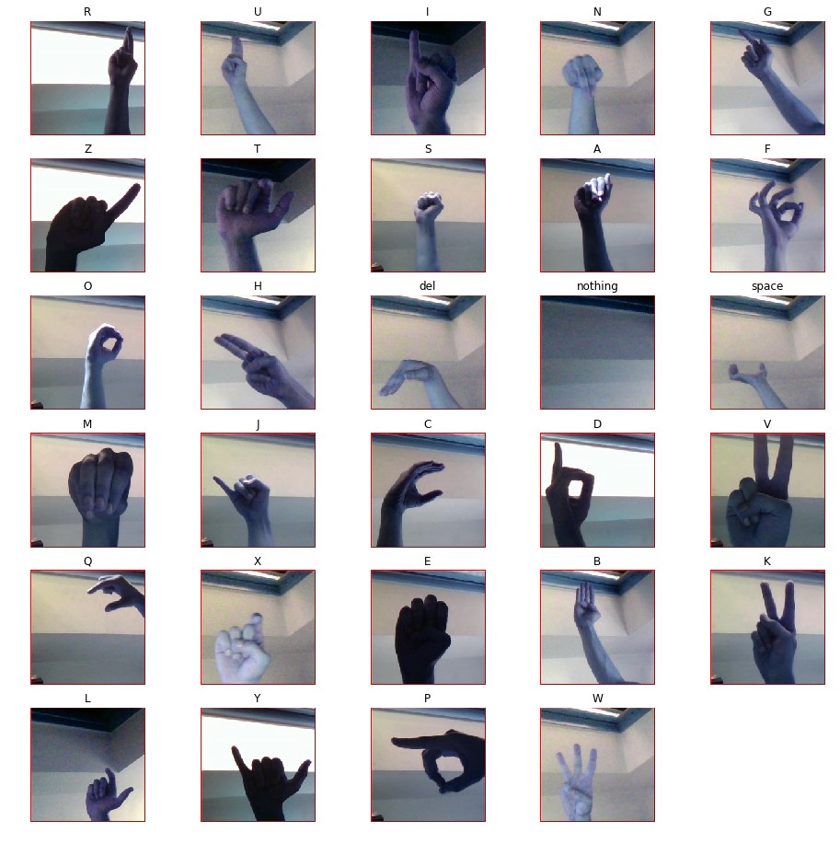
Example images
Used os.listdir to get label names from the folders
Use the label names as part of the path needed to plot the image

Slide 5
Data Preprocessing
Obtain the images as arrays:
Normalize data by dividing arrays by 255 so each pixel is a value between 0 and 1
Convert labels from its class to a numbered label and then encode the labels
Shuffle the data, then split into training/testing
Data augmentation

Slide 6
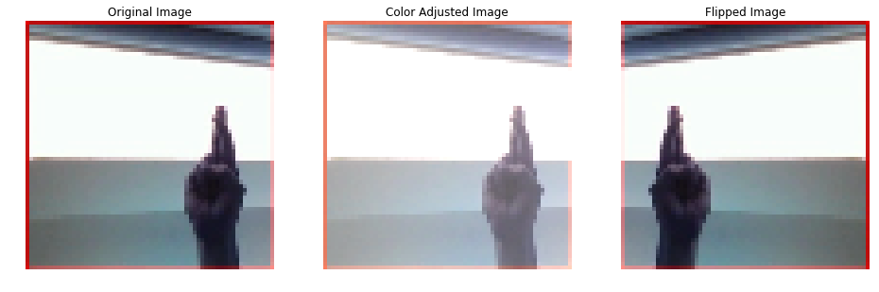
Data Augmentation
Flipped images horizontally
Randomly adjusted the hue, brightness, and contrast

Slide 7
Model Building
Used a CNN architecture with the following Keras layers:
Conv2d
Flatten
Dense (100)
Dropout
Dense (100)
Dense (29)
Compiled with:
Adam optimizer
Categorical cross-entropy loss

Slide 8
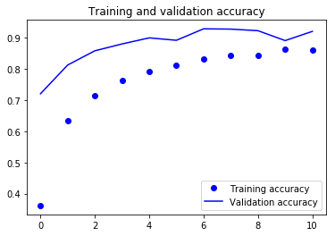
Model Training Accuracy

Slide 9
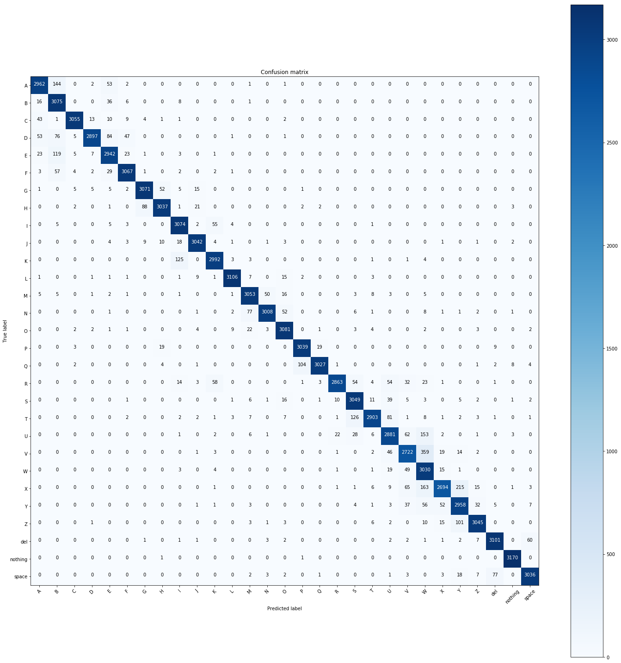
Confusion Matrix

Slide 10
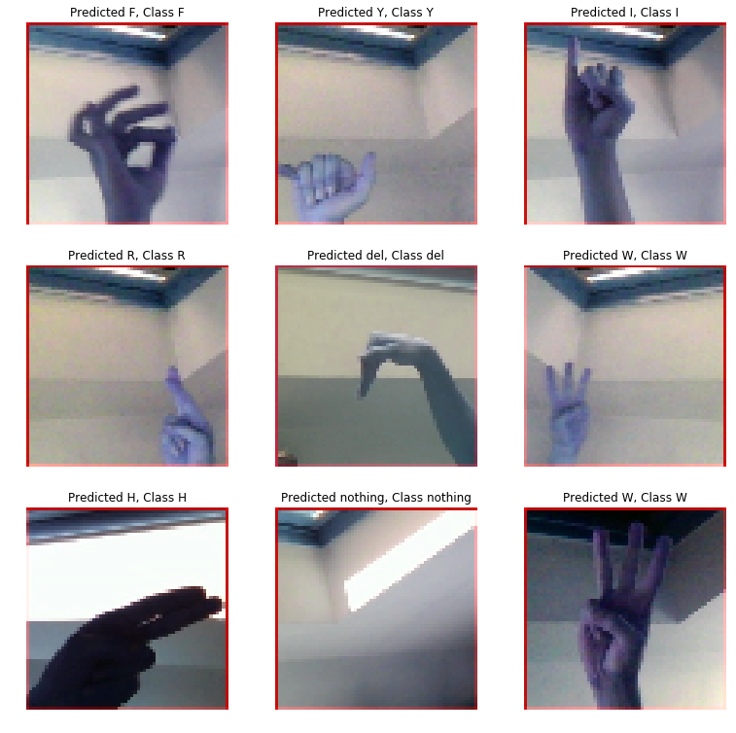
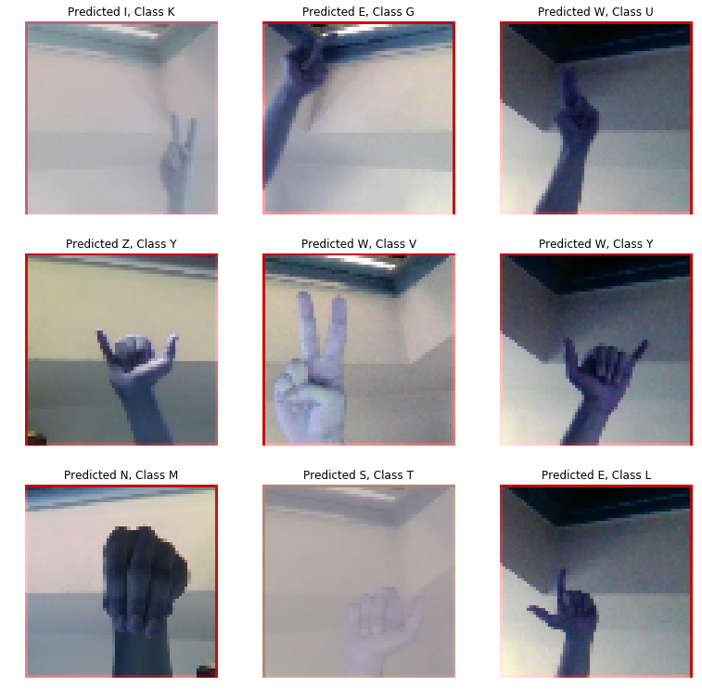
Correctly and Incorrectly Labelled Images

